Slide 1
A closer look at the repositories’ world
Rafael Andrade Buono, PhD
Data Steward at ELIXIR Belgium
Research Data Management: your ally on the way to your publication
15th June 2023, Gent

Slide 2
Do we know why?
Why submit data?
Why should we be aware of the repositories?

Slide 3

A (somewhat) simple start
Alice is a researcher who:
Works with plants
Is generating whole genome sequencing data
Makes use of several public platforms for tools and data
Has the current project funded by a public funding agency
Aims at publishing work in an open and peer reviewed journal

Slide 4
A (somewhat) simple start
Alice is a researcher who:
Works with plants
Is generating whole genome sequencing data
Makes use of several public platforms for tools and data
Has the current project funded by a public funding agency
Aims at publishing work in an open and peer reviewed journal
What is written in the DMP?

Slide 5
A (somewhat) simple start
Alice is a researcher who:
Works with plants
Is generating whole genome sequencing data
Makes use of several public platforms for tools and data
Has the current project funded by a public funding agency
Aims at publishing work in an open and peer reviewed journal
What is written in the DMP?
Are you cleared for depositing?
Ethical and legal issues
Data availability requirements of the funder and of the journal

Slide 6
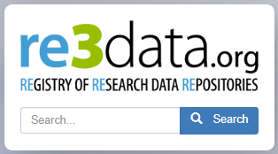

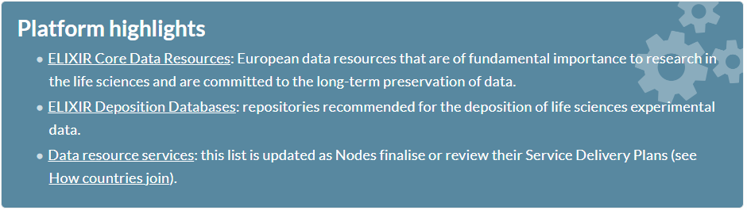
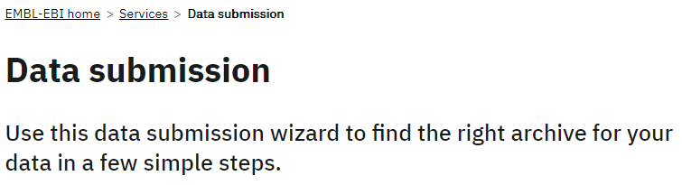
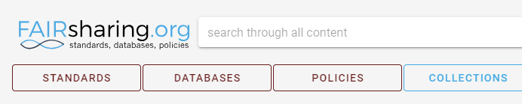
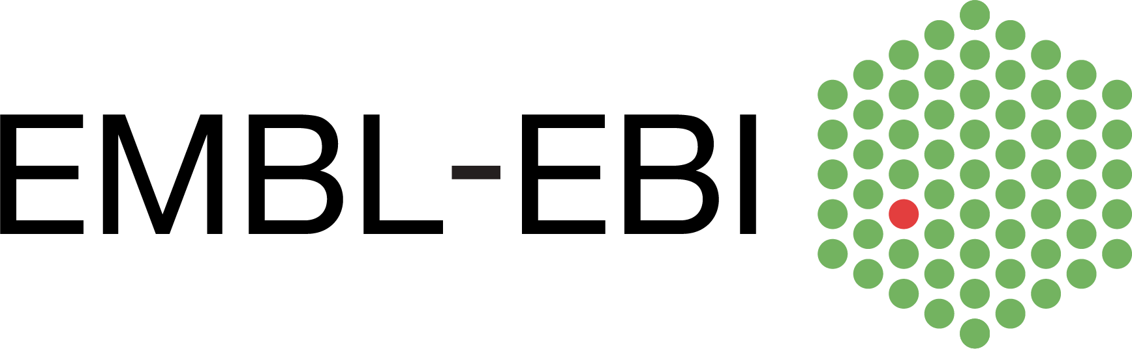
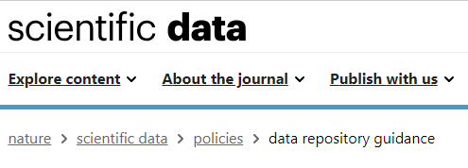

How to find a repository?
https://www.re3data.org/
https://elixir-europe.org/platforms/data
https://fairsharing.org/
https://www.ebi.ac.uk/submission/
Hey, Jim!
Where am I supposed to deposit this data?
Deposit?
I usually just ship a usb drive upon request!
https://www.nature.com/sdata/policies/repositories

Slide 7
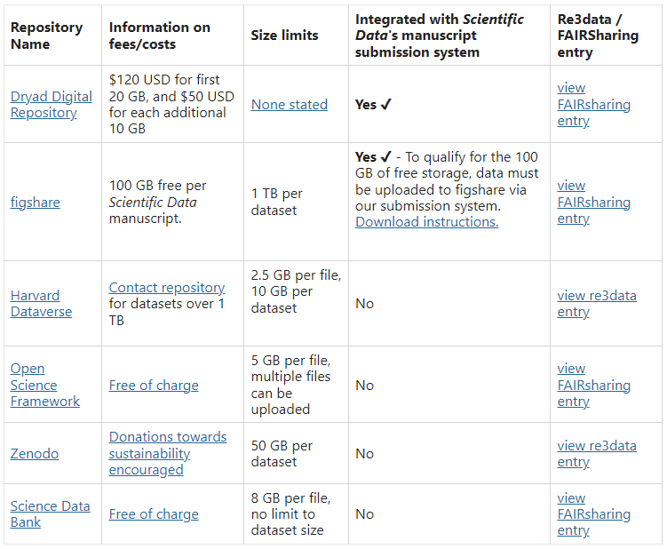
Generic vs. Domain specific
There are a few generalist repositories out there
Your institution might have a data repository that fulfils requirements from funders and journals
They might still not match your data type
Where do you find data?
Which repository can best connect you with the broader community?
https://www.nature.com/sdata/policies/repositories

Slide 8


Let's find a repository
Alice is a researcher who:
Works with plants
Is generating whole genome sequencing data
Makes use of several public platforms for tools and data
Has the current project funded by a public funding agency
Aims at publishing work in a open and peer reviewed journal
https://www.re3data.org/
https://fairsharing.org/
Identify a couple of potential repositories using re3data and FAIRsharing
Domain specific
Justify the choice

Slide 9
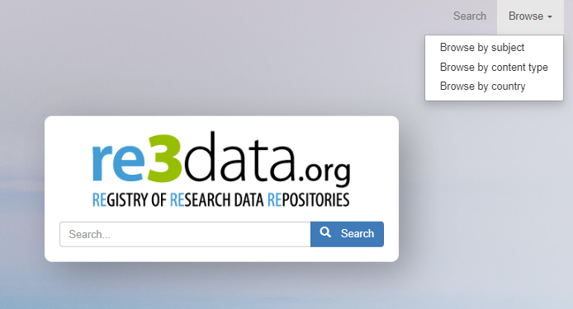
How to find a repository?

Slide 10
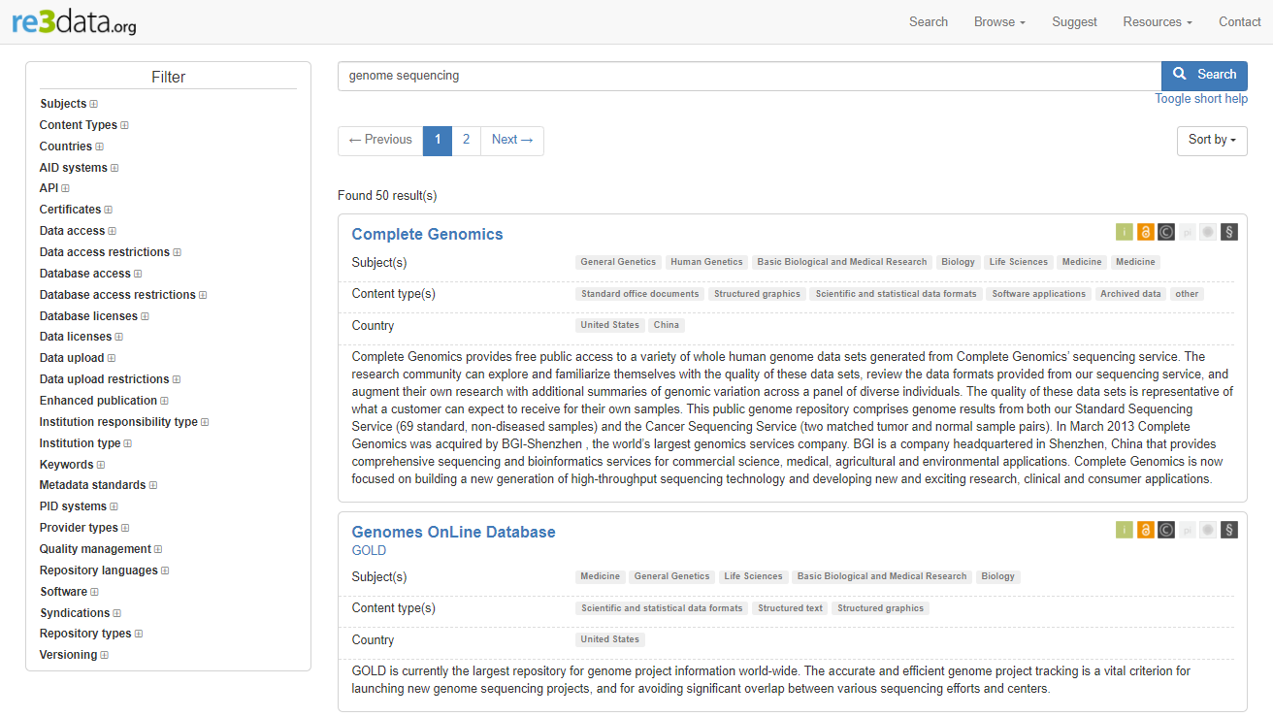
How to find a repository?
https://www.re3data.org/

Slide 11
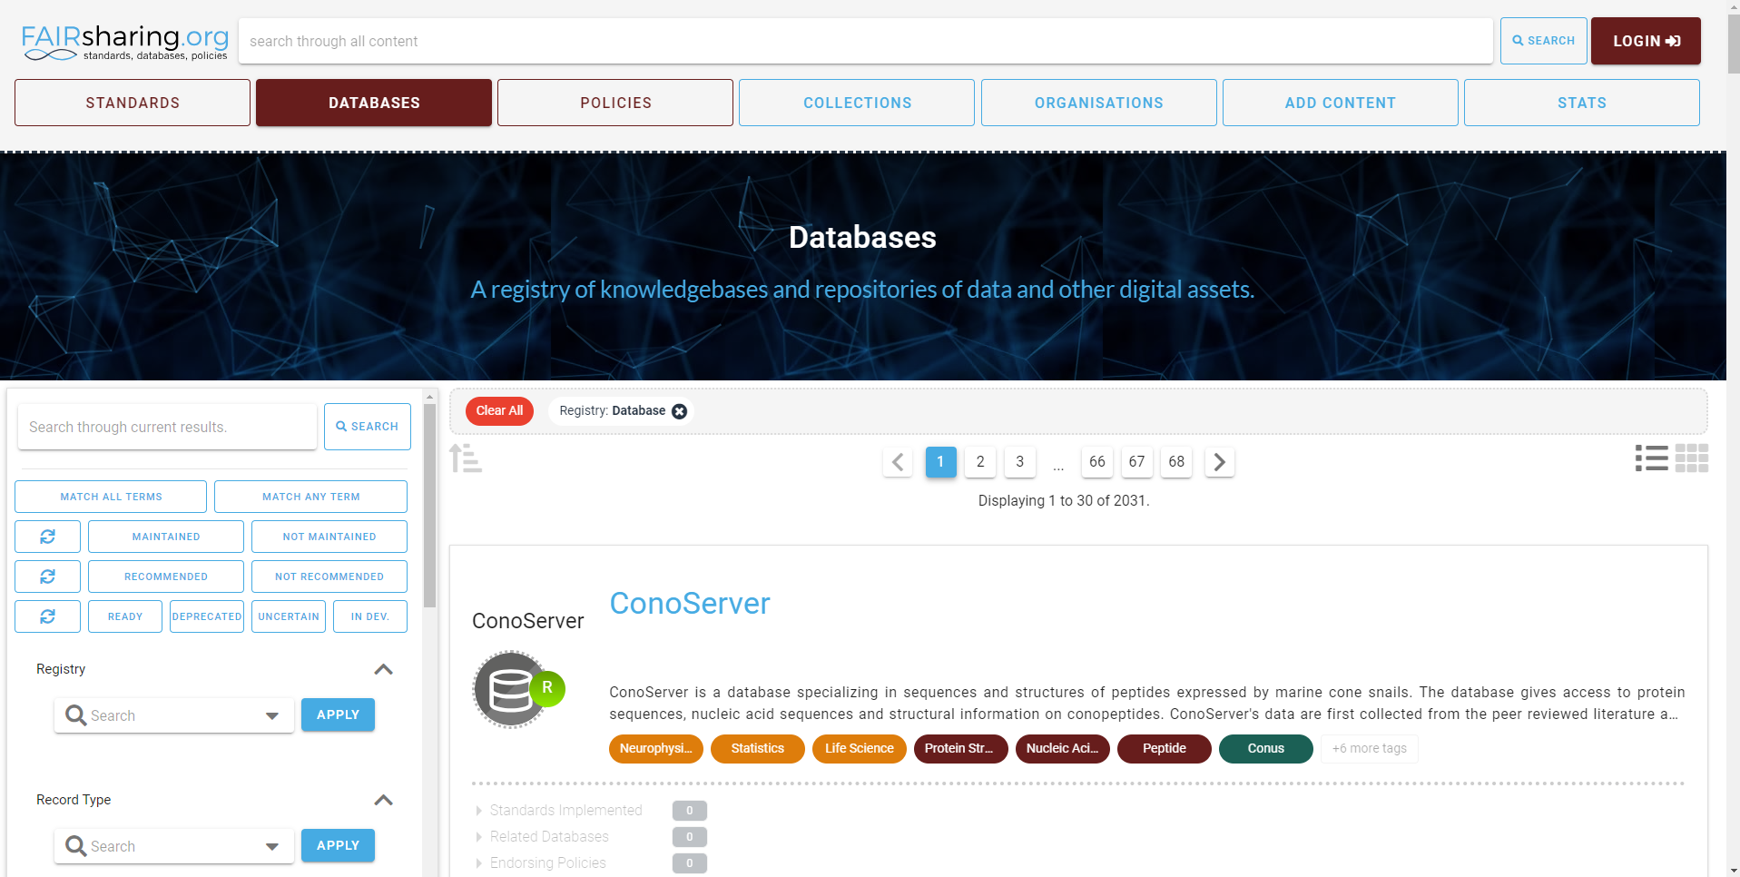
How to find a repository?

Slide 12
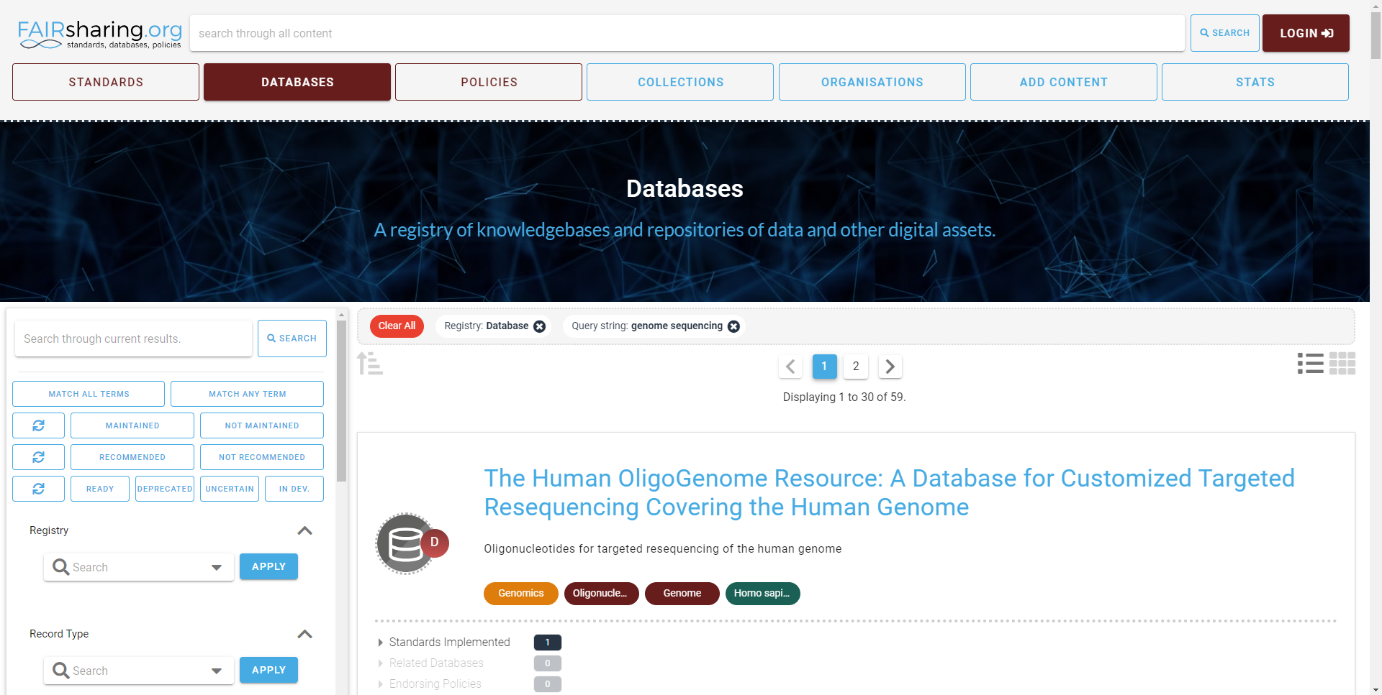
How to find a repository?

Slide 13
Let's find a repository
Alice is a researcher who:
Works with plants
Is generating whole genome sequencing data
Makes use of several public platforms for tools and data
Has the current project funded by a public funding agency
Aims at publishing work in an open and peer reviewed journal
https://www.re3data.org/
https://fairsharing.org/
Identify a couple of potential repositories using re3data and FAIRsharing
Domain specific
Justify the choice
Bonus: what information can you find about the repository that might help you?

Slide 14
Other ways to find a repository
https://elixir-europe.org/platforms/data
Focus on Life Sciences

Slide 15
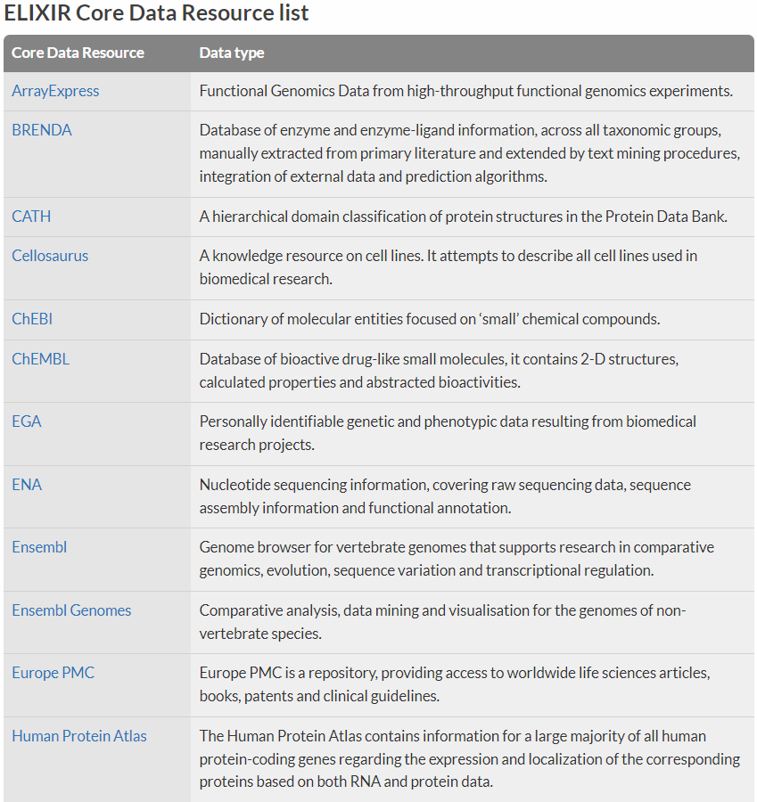
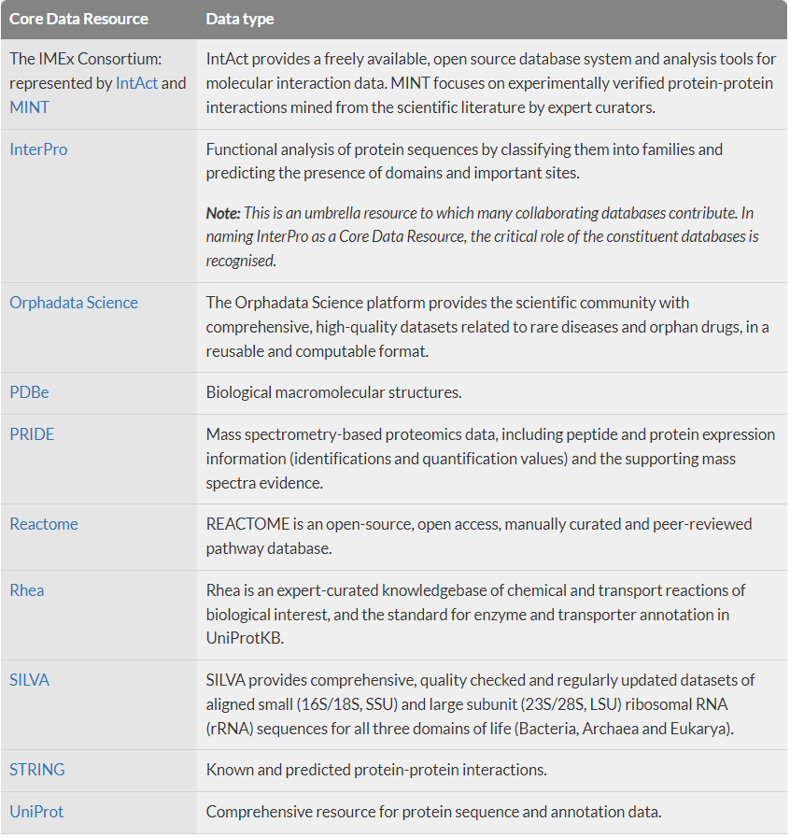
The ELIXIR Core Data Resources
https://elixir-europe.org/platforms/data/core-data-resources

Slide 16
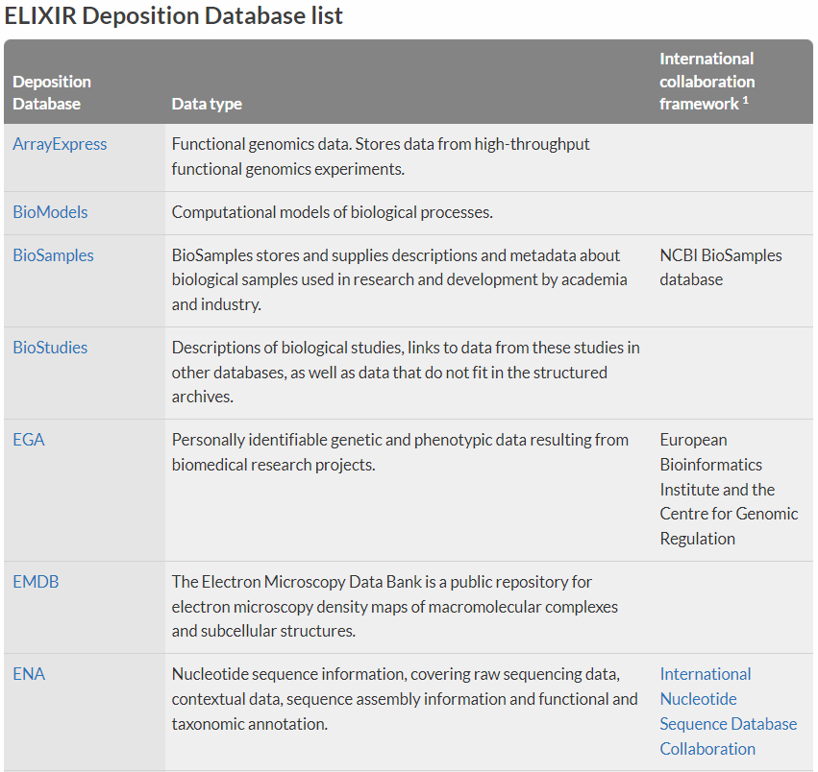
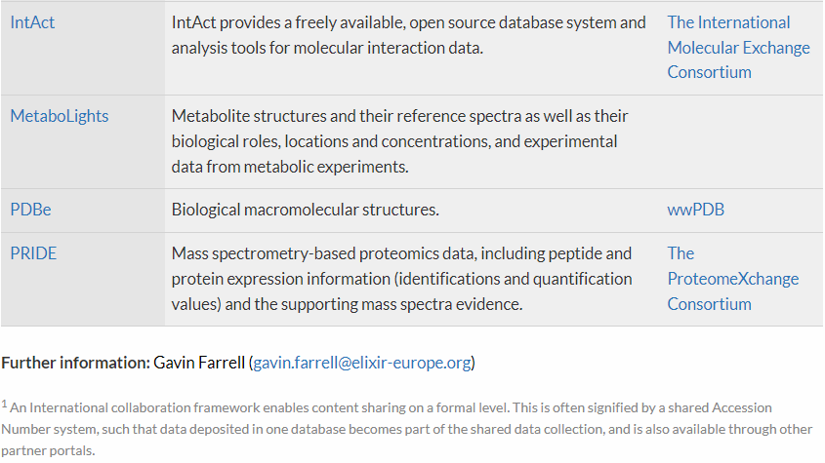
The ELIXIR recommended deposition databases
https://elixir-europe.org/platforms/data/elixir-deposition-databases
Focus on experimental data

Slide 17
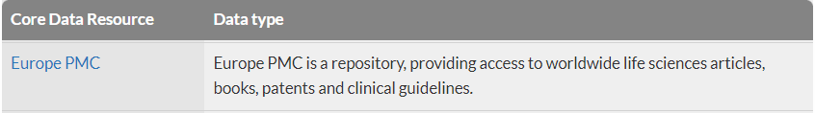
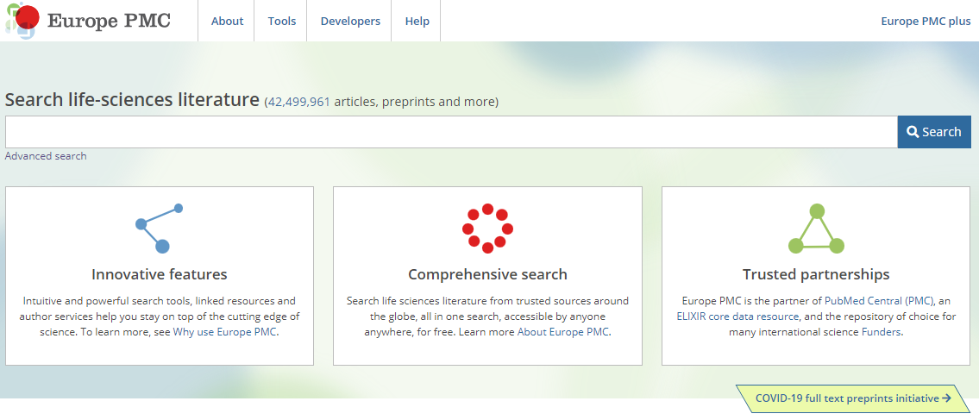
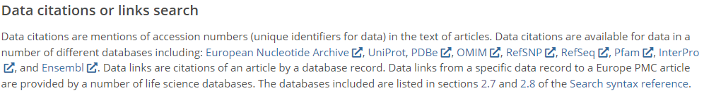
A short side note on visibility
Why is it a good idea to deposit your data?
https://europepmc.org/Help#searchdata

Slide 18
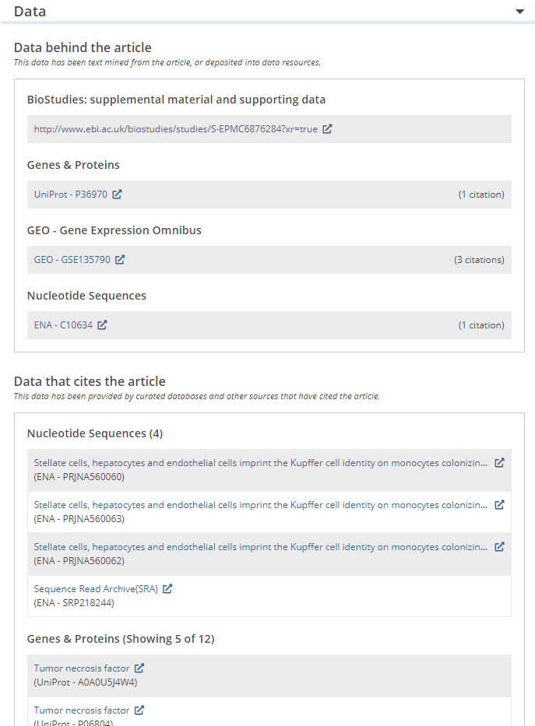

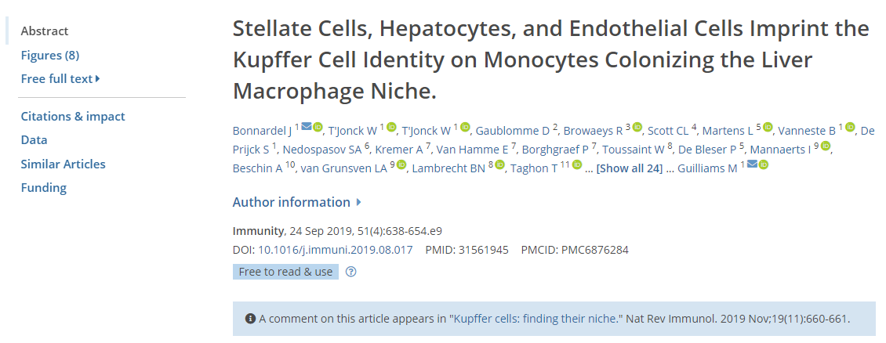
Cross referencing resources
Why is it a good idea to deposit your data?
Annotating publications with the related data

Slide 19
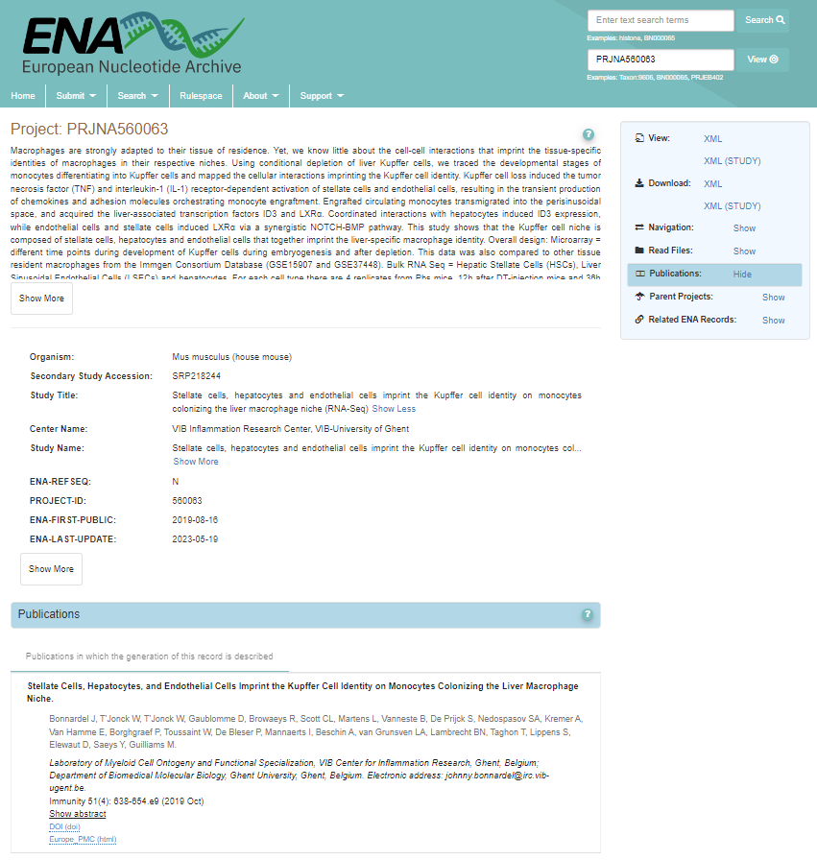
Cross referencing resources
Why is it a good idea to deposit your data?
Annotating publications with the related data

Slide 20
Cross referencing resources
Why is it a good idea to deposit your data?
Annotating publications with the related data

Slide 21
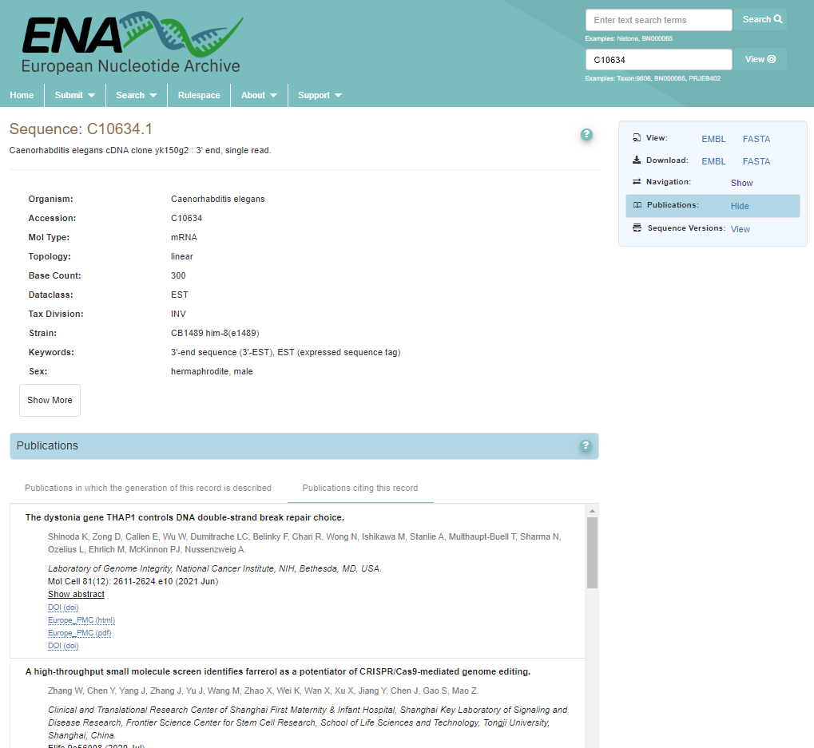
Cross referencing resources
Why is it a good idea to deposit your data?
Data citation as an impact metric

Slide 22
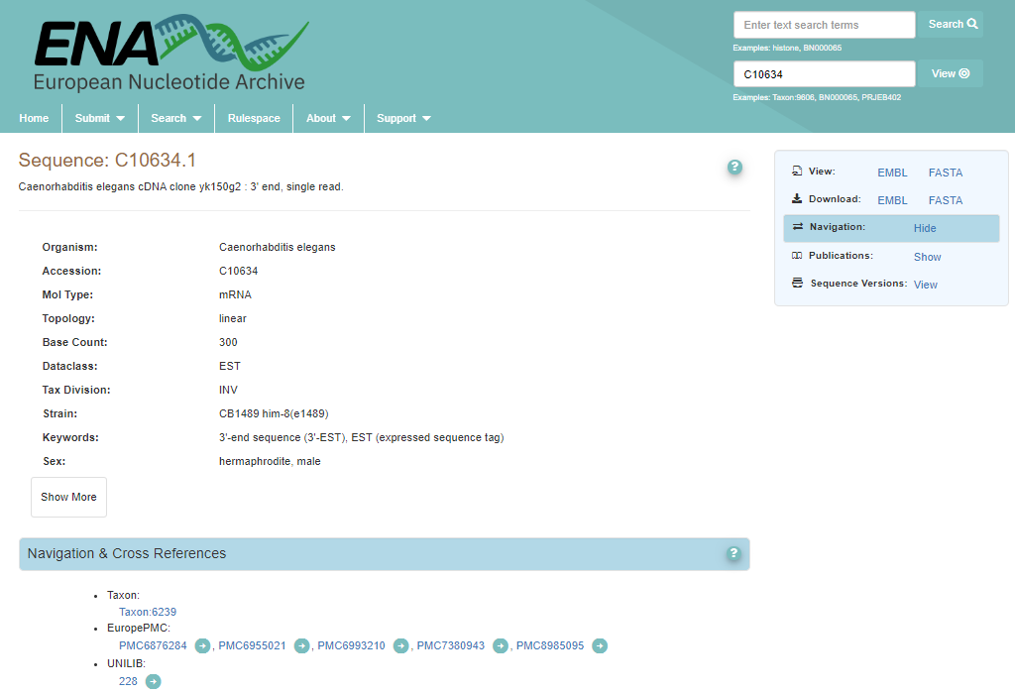
Cross referencing resources
Why is it a good idea to deposit your data?

Slide 23
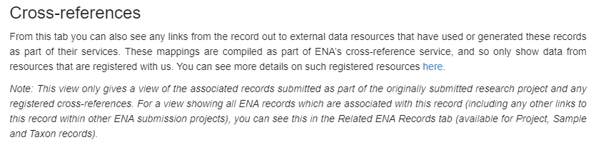
Cross referencing resources
Why is it a good idea to deposit your data?

Slide 24
Many ways to find
How do I know which data goes where?

Slide 25
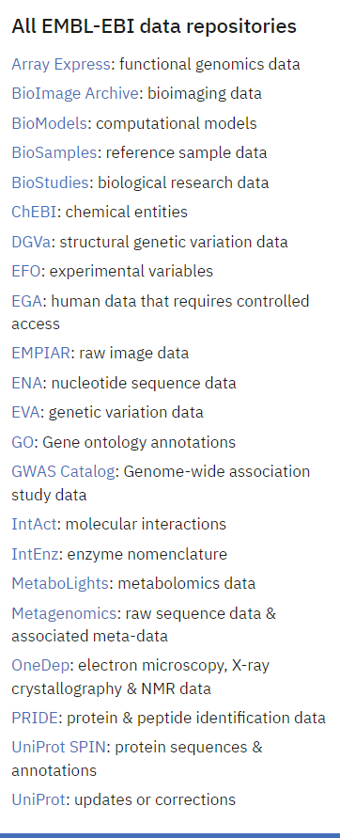
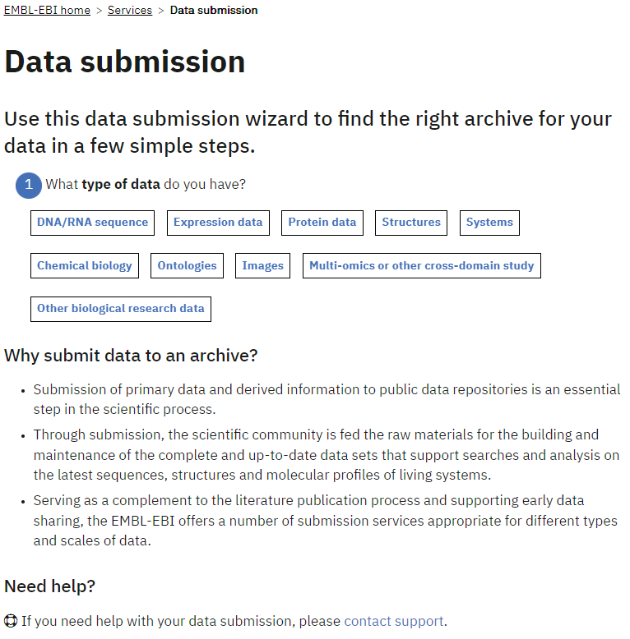
A wizard can be of help
https://www.ebi.ac.uk/submission/

Slide 26
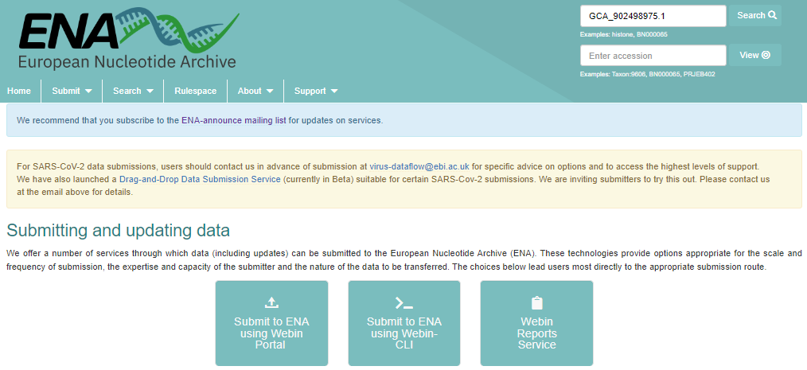
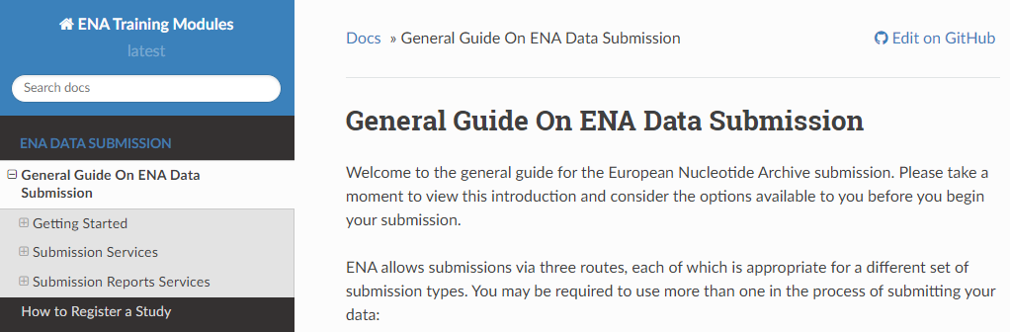
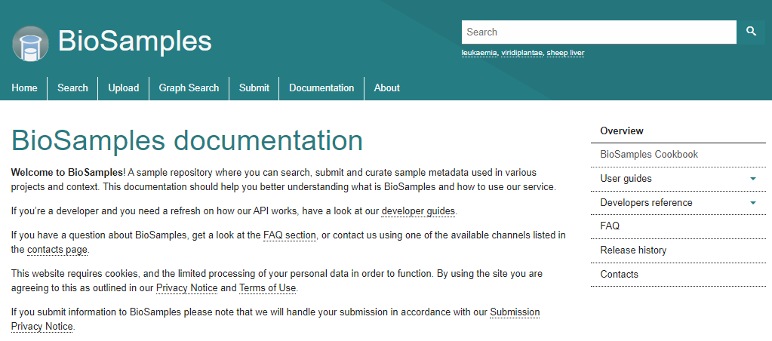
Data submission
Different repositories = different routes
What file formats are expected?
What metadata is expected?
Can ontologies and controlled vocabularies be used?
Are there costs involved?
Is there a license to be applied? Is it implicit?
https://www.ebi.ac.uk/ena/browser/submit
https://ena-docs.readthedocs.io/en/latest/submit/general-guide.html
https://www.ebi.ac.uk/biosamples/docs

Slide 27
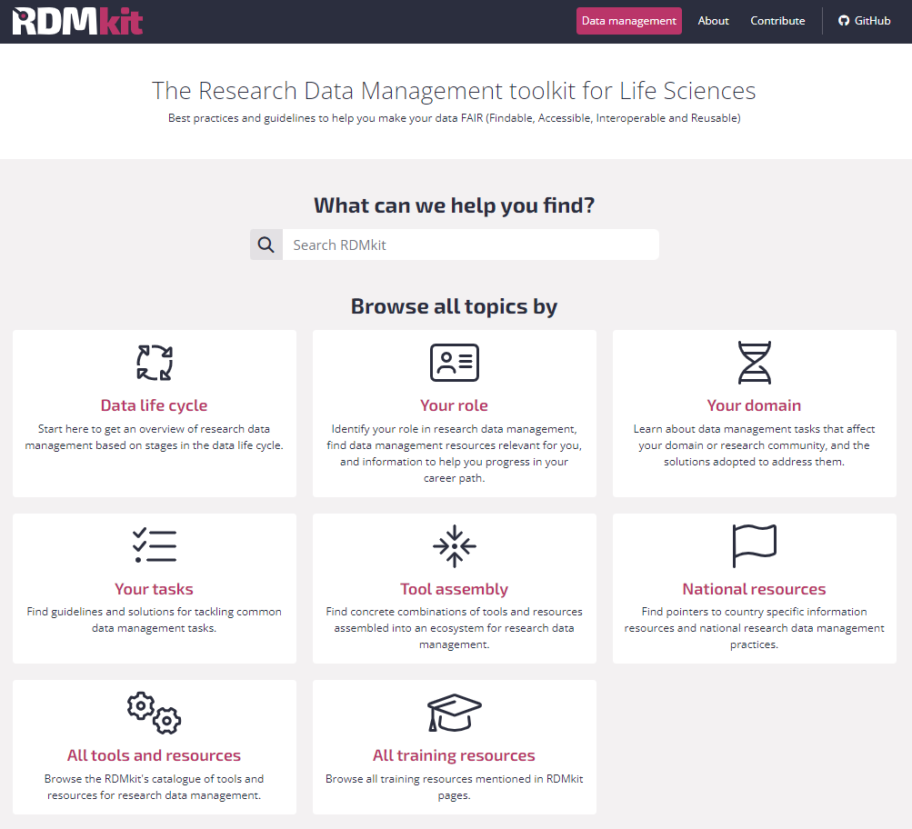
Other ways to find a repository
Community driven content
https://rdmkit.elixir-europe.org

Slide 28
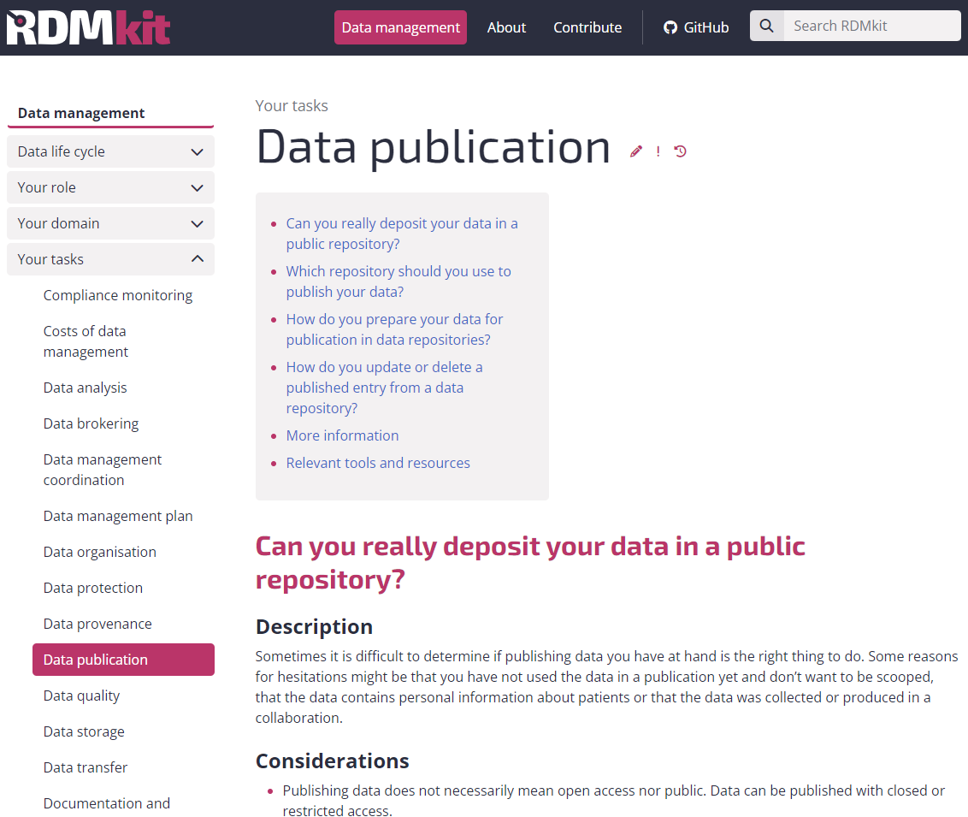
Other ways to find a repository
https://rdmkit.elixir-europe.org/data_publication

Slide 29
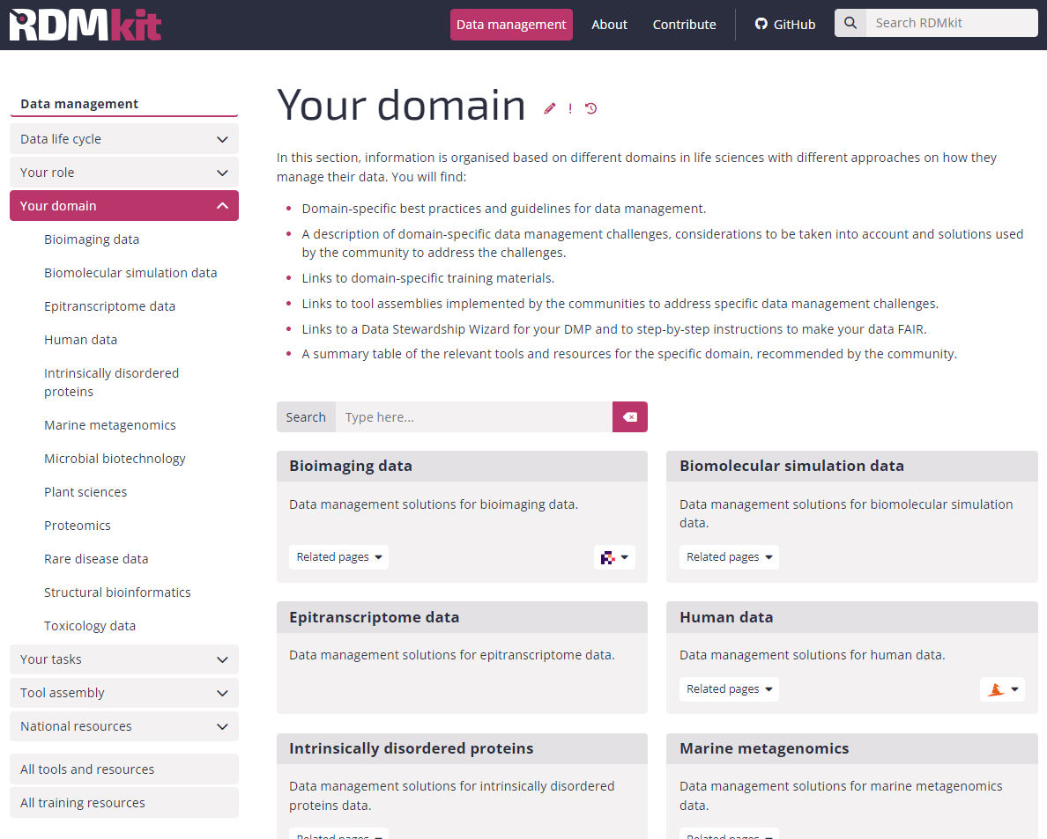
Other ways to find a repository
Are there recommendations for the domain?
https://rdmkit.elixir-europe.org

Slide 30
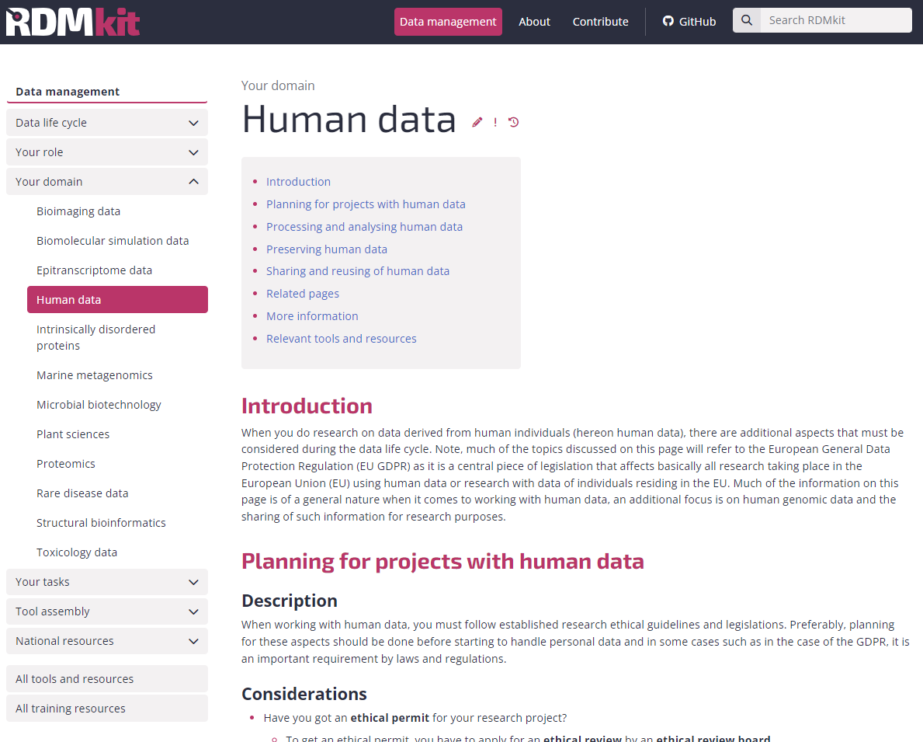
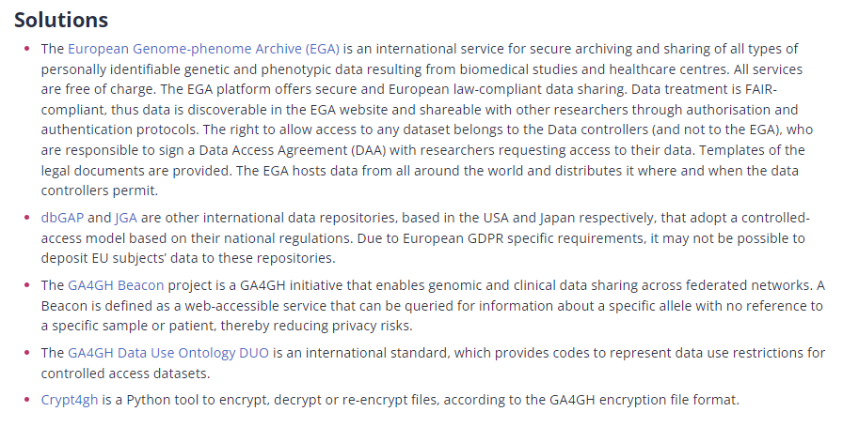
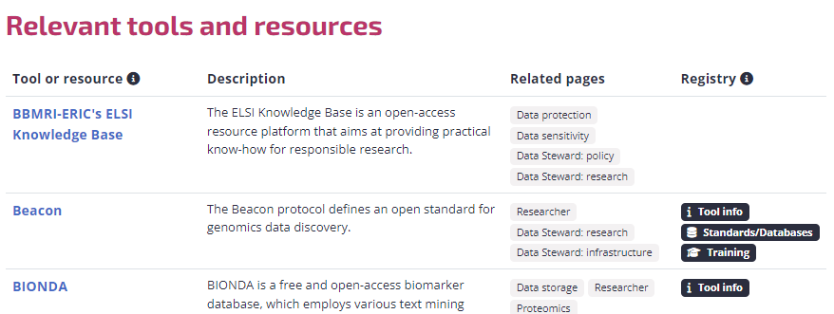
Other ways to find a repository
https://rdmkit.elixir-europe.org/human_data

Slide 31
Other ways to find a repository
Tool assemblies
Combinations of tools and resources to tackle a use case
https://rdmkit.elixir-europe.org

Slide 32

Let's find a repository
Alice is a researcher who:
Works with plants
Is generating whole genome sequencing data
Makes use of several public platforms for tools and data
Has the current project funded by a public funding agency
Aims at publishing work in an open and peer reviewed journal
https://rdmkit.elixir-europe.org
Identify a repository based on information from RDMkit
Domain specific
Justify the choice
Bonus: can you find further resources that can help you?

Slide 33
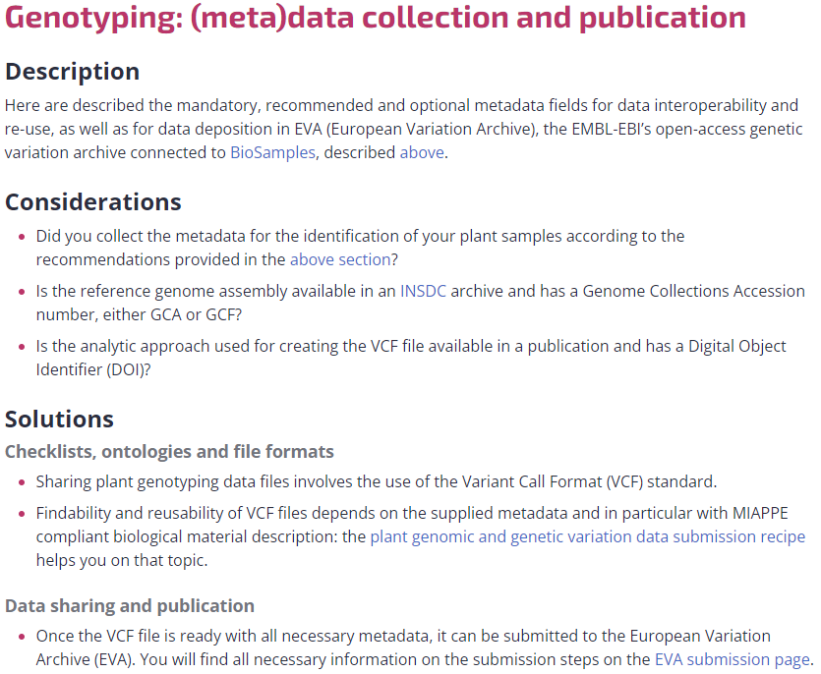
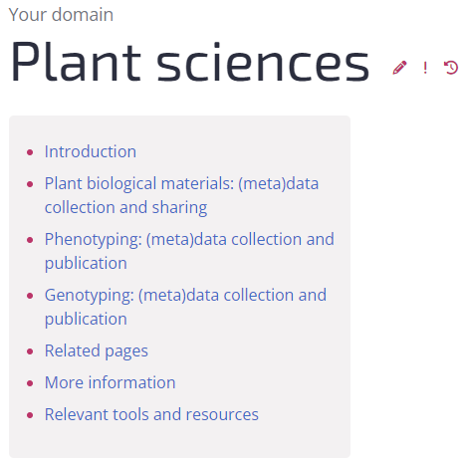
Other ways to find a repository
https://rdmkit.elixir-europe.org/plant_sciences

Slide 34
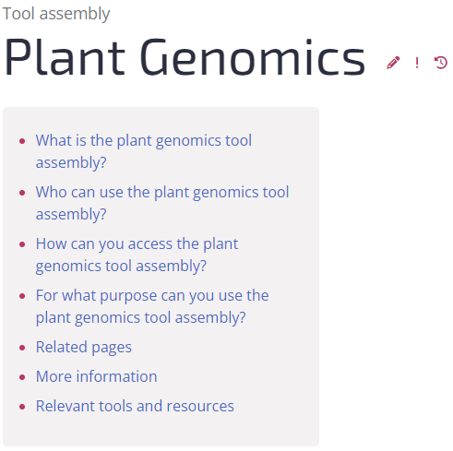
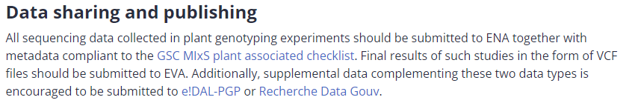
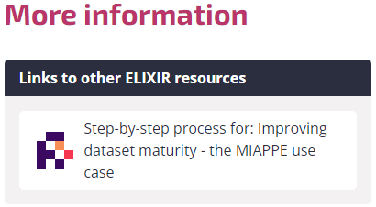
Other ways to find a repository
https://rdmkit.elixir-europe.org/plant_genomics_assembly

Slide 35
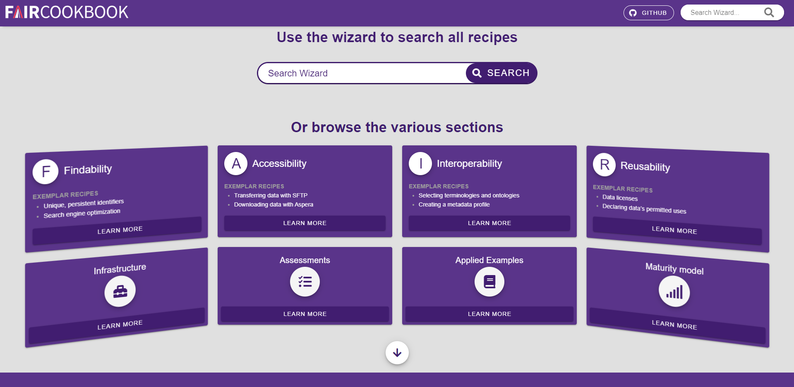
From guidelines to recipes
https://faircookbook.elixir-europe.org/

Slide 36
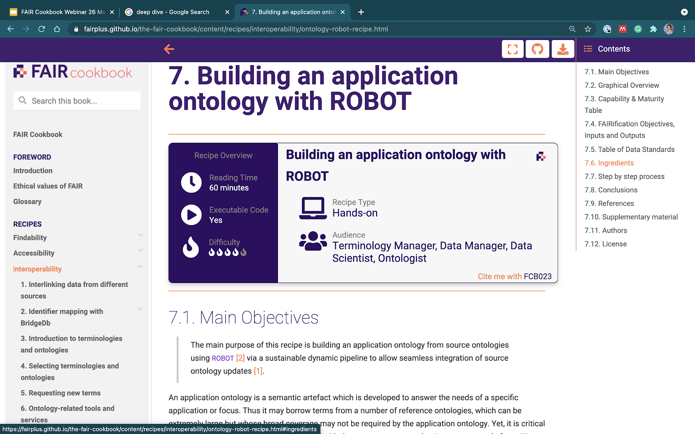
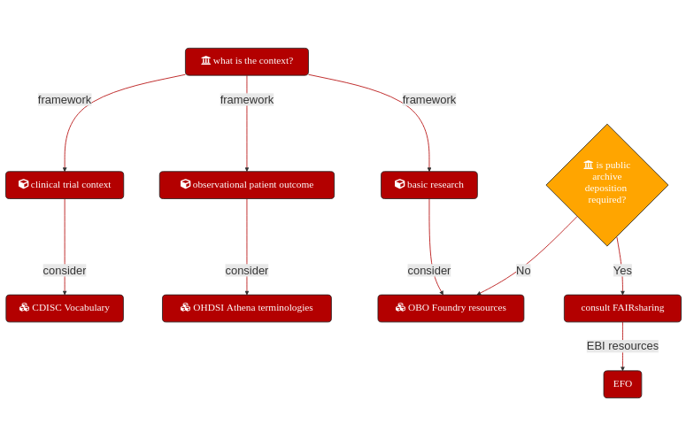

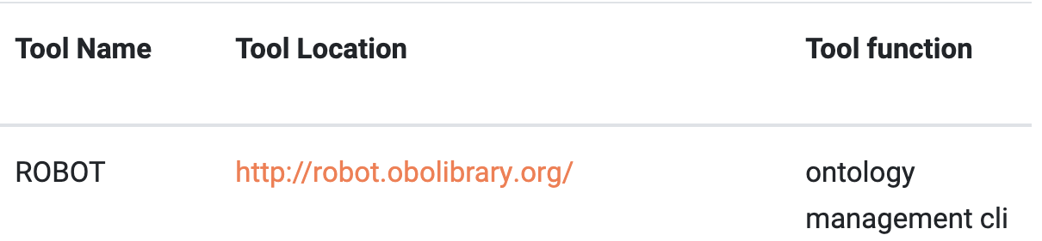
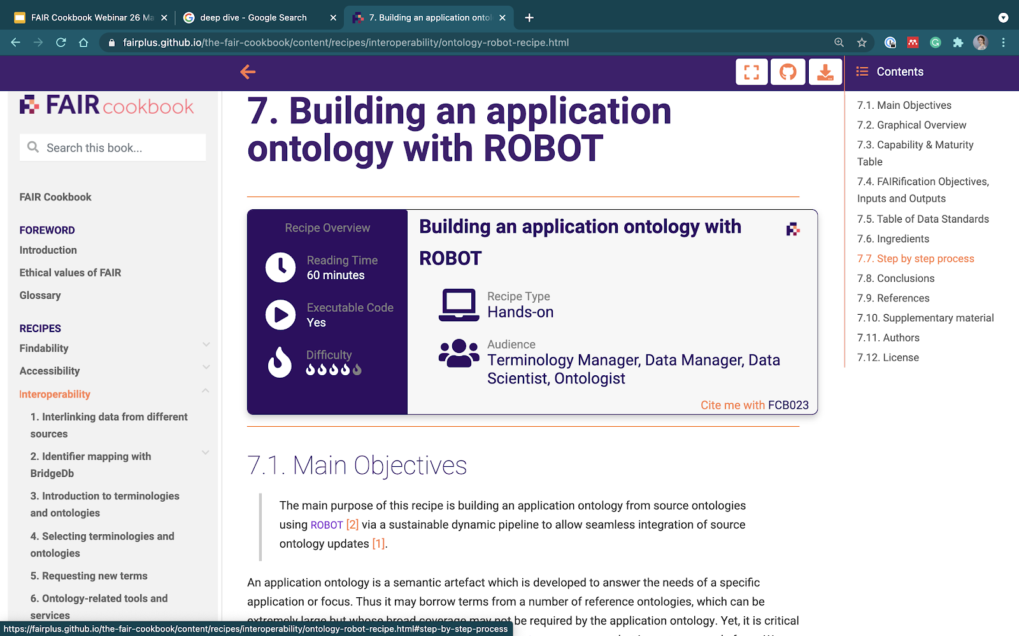
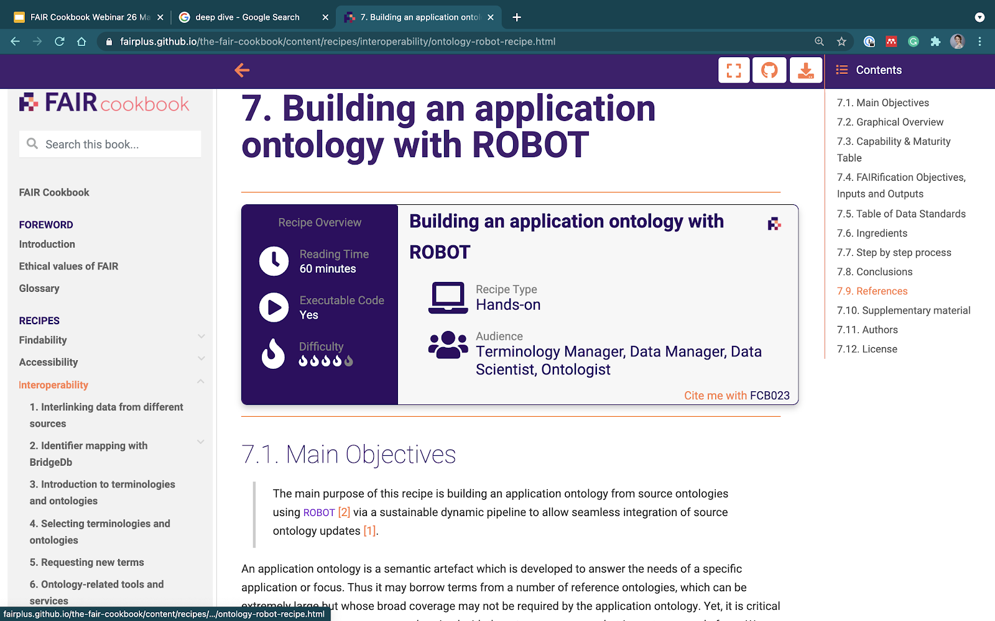
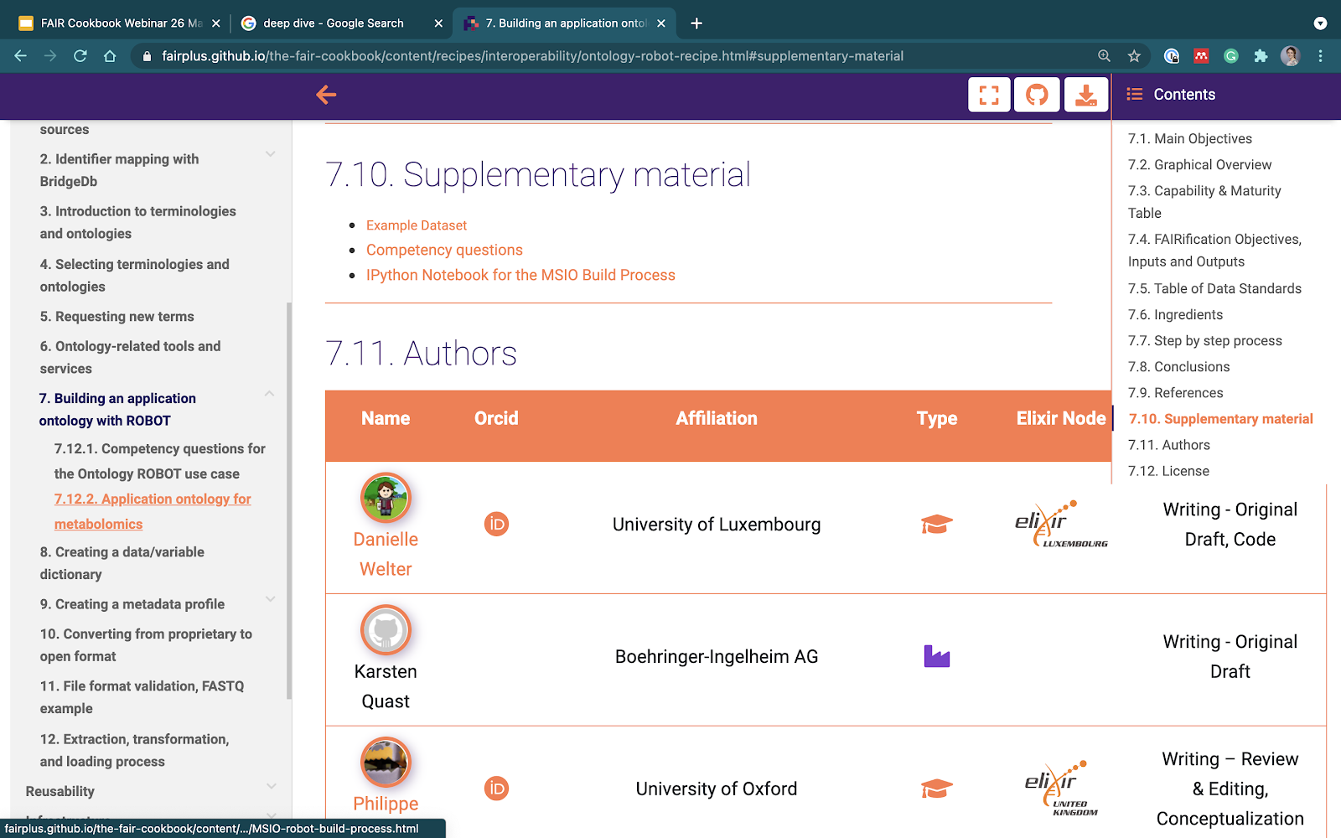
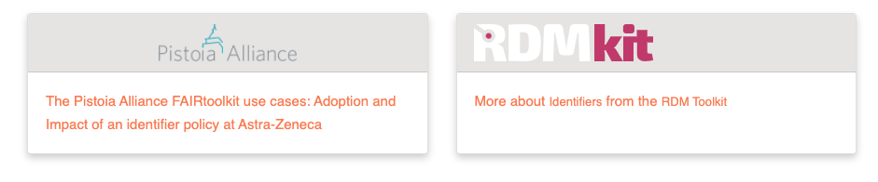
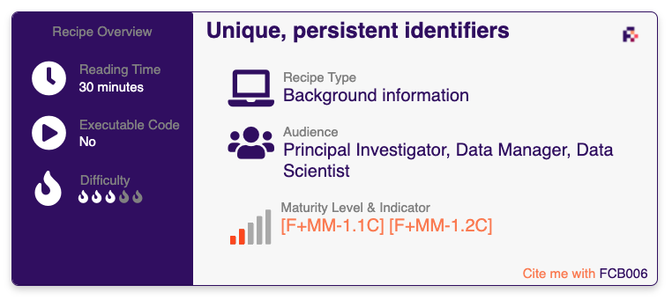
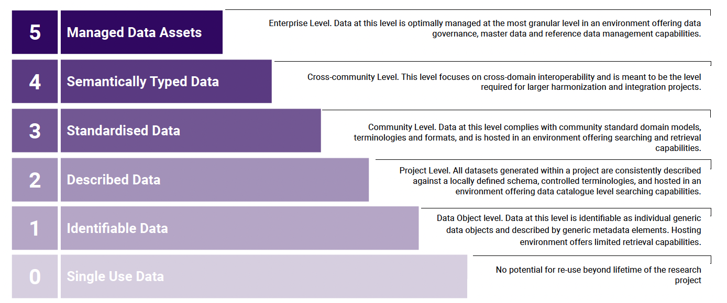
Anatomy of a recipe
Different levels of granularity
https://faircookbook.elixir-europe.org
Ingredients
An idea of tools/skills needed
Practical elements, code snippets
#Python3
#zooma-annotator-script.py file
def get_annotations(propertyType, propertyValues, filters = ""): "
Step by step process
Guidelines, process, description
Conclusions
What should I read next?
Examples
Provides insights into FAIR Maturity
https://doi.org/10.1038/s41597-023-02166-3

Slide 37
Other ways to find a repository
https://rdmkit.elixir-europe.org/plant_genomics_assembly

Slide 38

Other ways to find a repository
Which repositories are being used?
How are standards chosen?
https://w3id.org/faircookbook/FCB061

Slide 39


Multiple repositories with a similar data type
https://www.insdc.org/

Slide 40






Multiple repositories with a similar data type - Genomics
2017
SRA
Thank you to Alexander Botzki for original slide material

Slide 41










Multiple repositories with a similar data type - Proteomics
https://doi.org/10.1093/nar/gkz984
Thank you to Alexander Botzki for original slide material

Slide 42

Multiple repositories with a similar data type - Metabolomics
http://www.metabolomexchange.org/
Similar initiatives are being built

Slide 43

Multiple repositories with a similar data type - multi-omics
The Omics Discovery Index - OmicsDI
25 Resources
>3M Datasets
4 Continents
https://www.omicsdi.org/

Slide 44

Multiple repositories with a similar data type - multi-omics
The Omics Discovery Index - OmicsDI
Indexing metadata
The richer the metadata, the easier it is to find a dataset
https://www.omicsdi.org/

Slide 45
A multi-omics project
Alice is a researcher who:
Works with plants
Is generating whole genome sequencing data
Makes use of several public platforms for tools and data
Has the current project funded by a public funding agency
Aims at publishing work in an open and peer reviewed journal
Is also generating proteomics data
Is also generating metabolomics data
Would really like that the datasets are recognized as belonging to the same project
Identify
Suitable, domain specific, repositories
A strategy (repository) to help connect the datasets

Slide 46



Multi-omics

Slide 47

Multi-omics

Slide 48

Multi-omics
BioSamples
BioSamples
BioSamples

Slide 49
Multi-omics
BioSamples
BioSamples
BioSamples
BioSamples

Slide 50

Multi-omics
BioSamples
BioSamples
BioSamples
BioSamples

Slide 51

What about human sensitive data?
“The European Genome-phenome Archive (EGA) is a service for permanent archiving and sharing of personally identifiable genetic, phenotypic, and clinical data generated for the purposes of biomedical research projects or in the context of research-focused healthcare systems.”
https://ega-archive.org/
Central metadata access
Secure storage of sensitive data
Data access defined, including Data Access Committees (DAC)
Different datasets may have different DACs

Slide 52


Access types
Open access: Data is shared publicly. Open-access is a rarely used access mode for the sharing of human data. To use open-access researchers need to ensure that the data needs is anonymised, which is difficult in practice.
Registered access: Data is shared with researchers, who have been vouched for by their institution and who agree to abide by data usage policies. Datasets that are shared via registered-access would typically have no restrictions besides the condition that data is to be used for research.
Controlled access: Access is reviewed and approved by a data access committee (DAC). Typically researchers who were involved in the primary collection of data will form the DAC. There can be a multitude of usage conditions, including allowed research topics, geographical regions, and recipients e.g. non-profit organisations.
Modified from https://rdmkit.elixir-europe.org/human_data#sharing-and-reusing-of-human-data

Slide 53

Re-using data from the EGA
Submission after a Data Processing Agreement
A scientist discovers the dataset (e.g. through a publication or by navigating the EGA)
The DAC is contacted and a DAA is defined
EGA is informed of access permission
Scientist can access the data
Data is downloaded and re-used
https://doi.org/10.1093/nar/gkab1059

Slide 54

Re-using data from the EGA
https://ega-archive.org/about/ega-statistics

Slide 55


Submitting data to the EGA
https://ega-archive.org/submission
What if the data cannot leave my country?
https://ega-archive.org/submission/quickguide

Slide 56

Federated EGA
“Federated EGA strives to support the discovery of and secure access to human data globally, while respecting national data protection regulations, with the goal of accelerating disease research and understanding and improving human health.”
https://doi.org/10.7490/f1000research.1118988.1
https://ega-archive.org/federated
Launched in September 2022
Data does not leave the Local EGA
Dataset discovery through the Central EGA

Slide 57




Central EGA
Signed FEGA Collaboration Agreement
Federated EGA
Joined FEGA Committees
Engaged in work to establish a FEGA node
Expressed interest in joining FEGA Network
https://ega-archive.github.io/FEGA-onboarding/
Modified from https://doi.org/10.7490/f1000research.1119478.1

Slide 58







A short side note on computational workflows
Where can I find workflows?
Platform/System specific repositories
The Git based repositories
Generalist data repositories
IWC - Intergalactic Workflow Commission

Slide 59

Using a registry to overcome fragmentation
Start: April 2020
Launch: Sept 2022
https://workflowhub.eu/

Slide 60


WorkflowHub
Key features
System agnostic
Native repository support
Git integration
Versioning
Links to external files (docs, test and reference data)
Metadata extraction and standards
Integration with Bio.tools
Author credit
Citable
DOI minting
A sandbox is available
https://dev.workflowhub.eu/
Modified from slide of Carole Goble at ELIXIR All Hands 2023

Slide 61


Integration with different platforms
https://usegalaxy.eu/
Connecting workflow discovery to analysis
DOI: 10.48546/workflowhub.workflow.482.3

Slide 62

A hands on possibility
Submission of read data to ENA through their interactive submission route
A plant genomics example
https://github.com/PBR/elixir-fondue-datathon
Example data files
Presentation slides
Instructions sheet
NEW URL FOR TEST SERVER: https://wwwdev.ebi.ac.uk/ena/submit/webin/
Submission interface has changed since this was generated
https://www.elixir-belgium.org/projects/fondue-fairification-plant-genotyping-data-and-its-linking-phenotyping-using-elixir
https://w3id.org/faircookbook/FCB061

Slide 63

Another hands on possibility
A SARS-CoV-2 example
Submission of read data of SARS-CoV-2 to ENA through their interactive submission route
https://ena-covid19-docs.readthedocs.io/en/latest/submission_workshop/getting_started.html

Slide 64


info@elixir-belgium.org
https://www.elixir-belgium.org
This work is licensed under the Creative Commons Attribution 4.0 International License.
To view a copy of this license, visit http://creativecommons.org/licenses/by/4.0/

